Slide 1
Accrual Accounting Can Save America’s Future
American Accounting Association
August 9, 2016
www.TruthInGovernment.org

Slide 2
Johnny – The Future of America

Slide 3
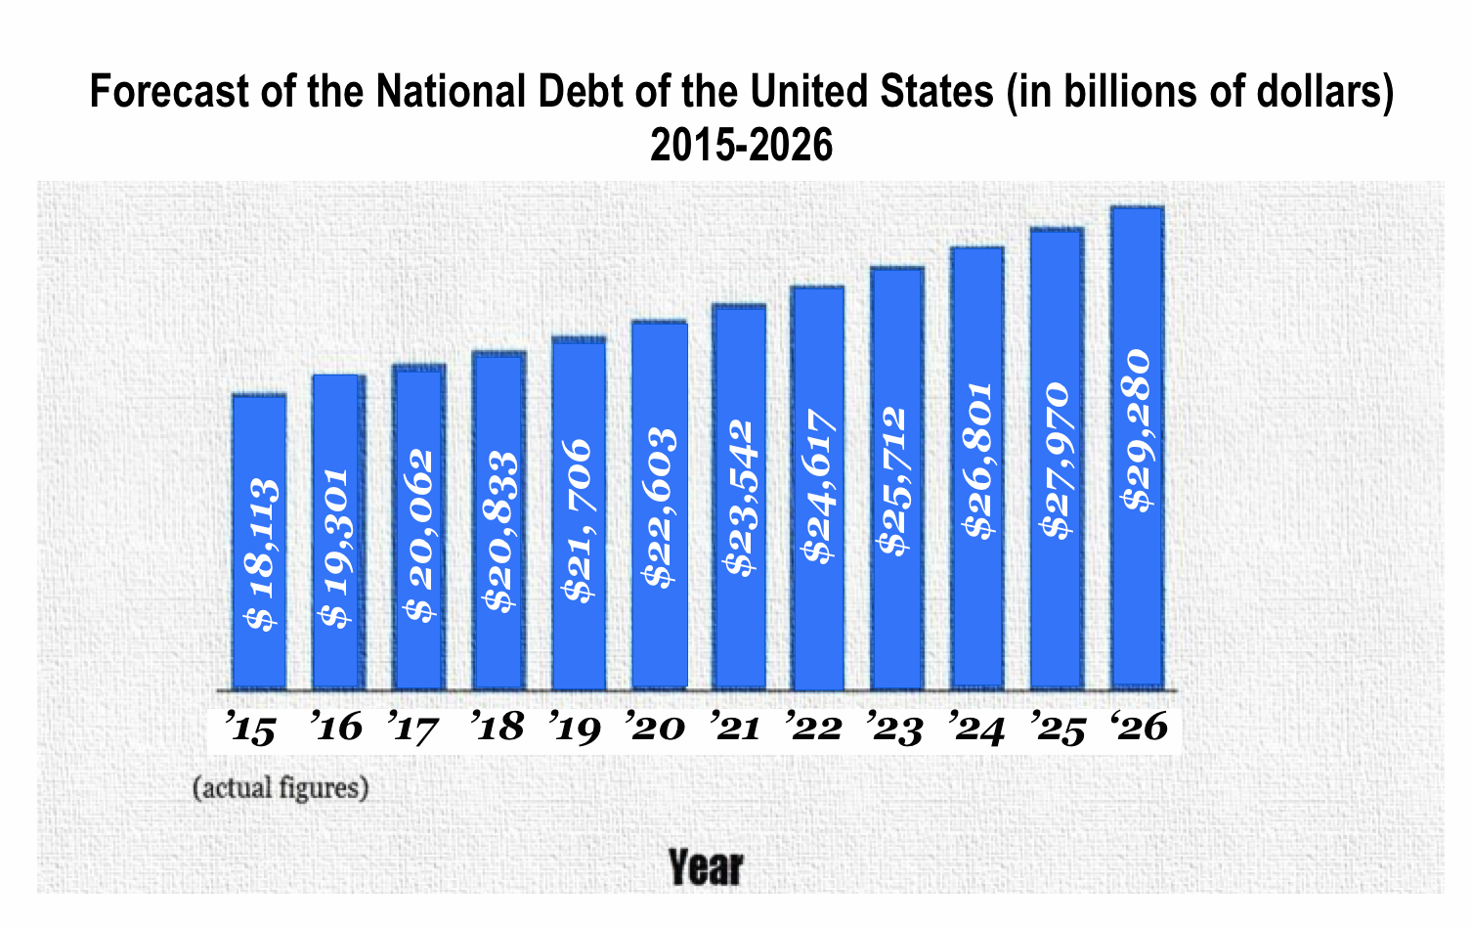
WHAT WE ARE TOLD
*CBO, 2016

Slide 4
A Ticking Time Bomb – Interest
Notes:
Percentages represent the total interest costs as a percent of the U.S. federal budget in respective years.
Cost on Net Interest on U.S. National Debt to surpass Defense spending by 2024.
Cost of Net Interest on U.S. National Debt to surpass $800 billion by 2026.

Slide 5
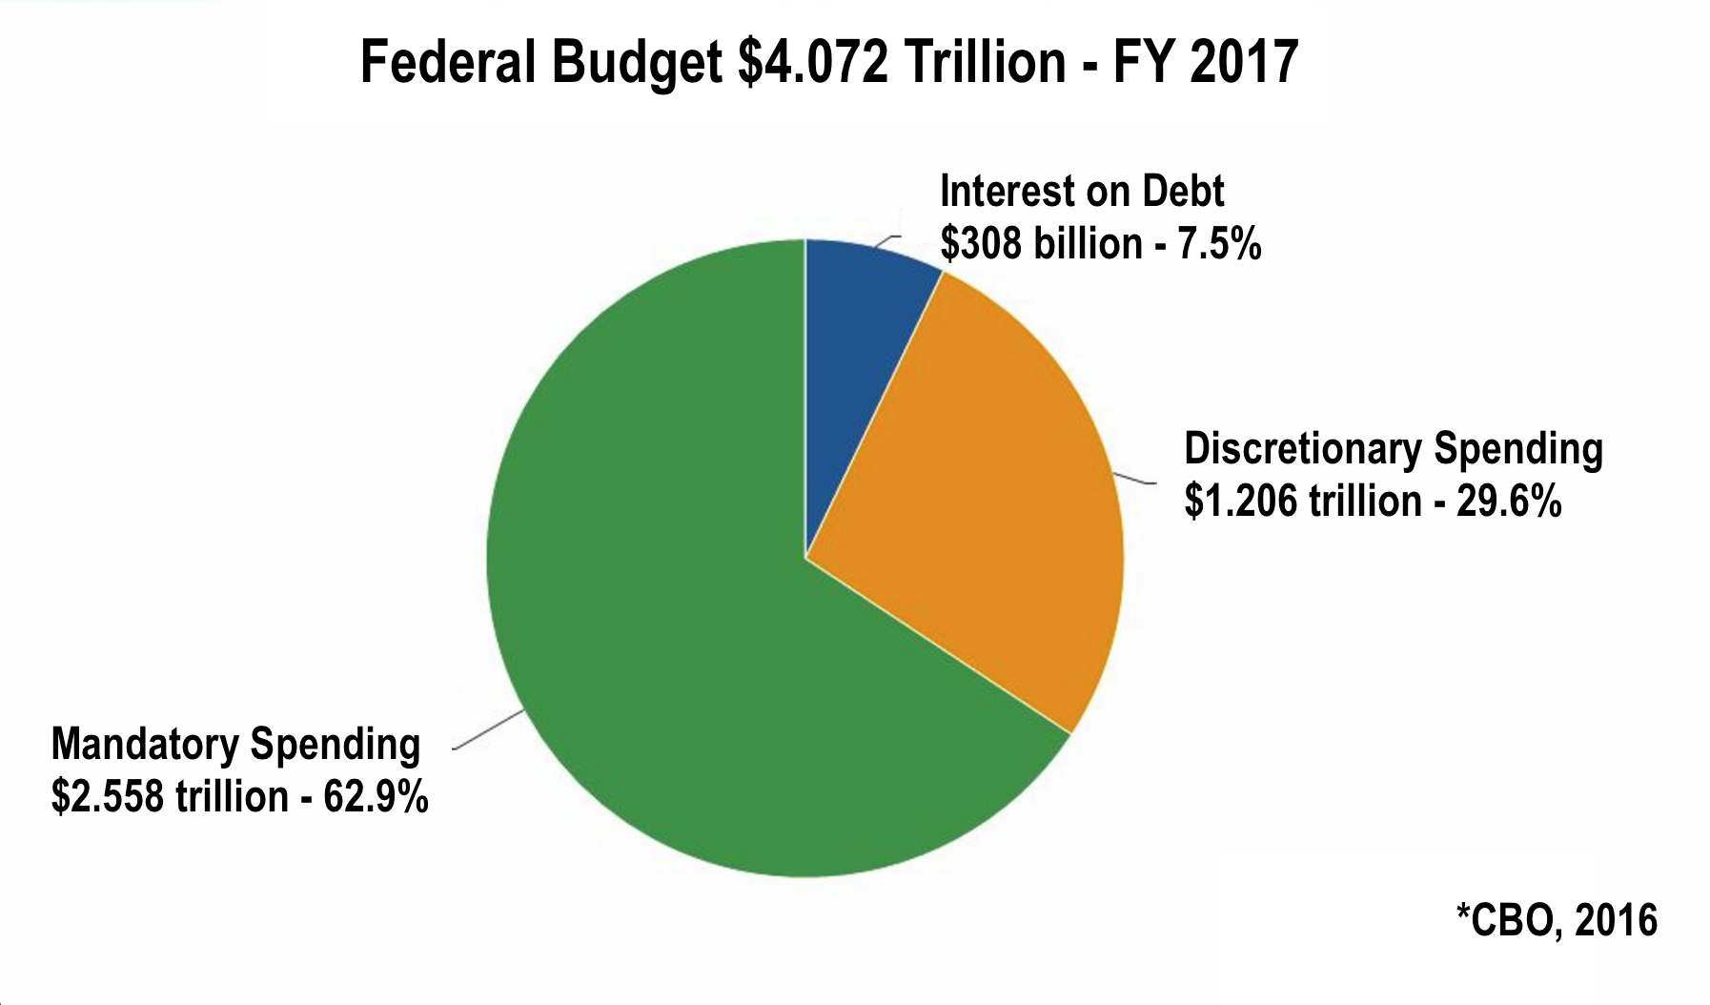
Notes:
Based on CBO data, mandatory federal spending is composed of Social Security, Medicare, Medicaid, Income Security (ie: Disability Insurance, EICTC, SNAP), and federal civilian and military retirement. (http://www.cbo.gov/sites/default/files/cbofiles/attachments/BS_Mandatory_print.pdf)
Mandatory spending was 13.6% as a share of GDP in 2011.
Defense and military expenditures are grouped under discretionary spending.
Defense comprises over 50% of the nation’s discretionary spending budget.

Slide 6
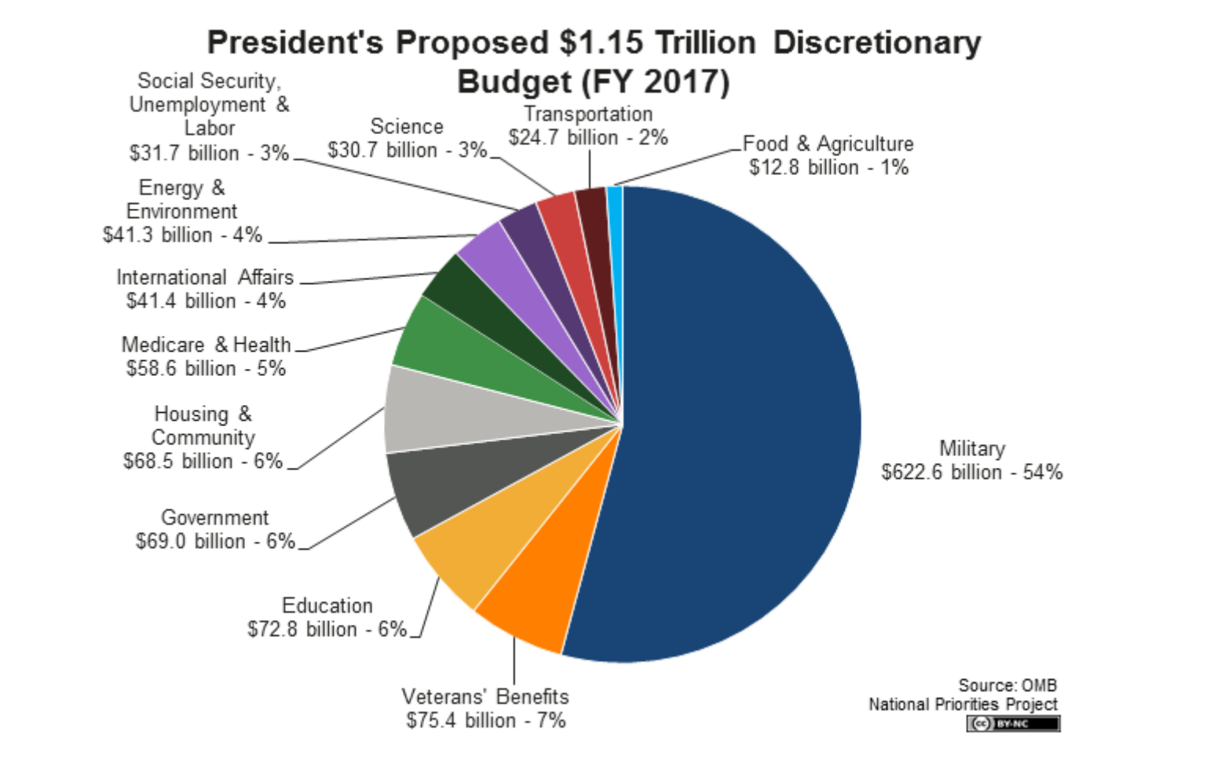

Slide 7
* Truth In Government
Source: World Bank
U.S. Treasury, July 2016
Notes:
U.S. National Debt on the accrual basis is over 4 times current GDP.
U.S. National Debt on the accrual basis represents nearly 4 times the national debt that the U.S. government is telling you.

Slide 8
CFO ACT OF 1990
In 1987, Congressman Joe DioGuardi introduced H. Res. 3142, The Chief Financial Officer Act, with 57 co-sponsors which, in addition to the the responsibilities of the Comptroller General, called for the preparation of annual financial statements for the U.S. government on the accrual basis.
In October 1990, a “Memorandum of Understanding on federal government accounting standards among the General Accounting Office, the Department of the Treasury, and the Office of Management and Budget” established the current Federal Accounting Standards Advisory Board (FASAB) to determine “accounting standards” that are appropriate for the U.S. government’s annual financial statements, as requested of the Director of the Office of Management and Budget in the 1990 CFO Act
In November 1990, President George H.W. Bush signed the CFO Act of 1990, establishing a Chief Financial Officer for the United States within the Office of Management and Budget for each major U.S. department and agency, and requiring the annual financial statements of the U.S. government to be publicized annually.
The CFO Act of 1990 that was signed into law did not include the express provision that the annual financial statements for the U.S. government be prepared on the accrual basis.

Slide 9
WHY ACCRUAL ACCOUNTING FOR THE U.S. GOVERNMENT IS NEEDED
“At its core, the cash basis system of accounting—a system which records financial transactions when income is received and expenses are paid—is a faulty way of measuring the government’s financial condition and cost of operations. Elected officials in Washington are accustomed to cash basis accounting because it provides them with the advantage of currying favor with today’s voters at the expense of tomorrow’s taxpayers.”
[Sound Financial Reporting in the U.S. Government, Arthur Andersen & Co., February 1986, p.7]
A modern day example of “taxation without representation.”
Notes:
In essence, it means that politicians can make promises to their constituents that commit the federal government to pay out future benefits, without currently recognizing the future costs of these commitments. And, while these costs may not affect us in the short-term, they are effectively part of our national debt—for which our children and future generations of Americans will be responsible to pay. By making promises under long-term, mandated programs, politicians are forcing future generations of Americans to raise taxes in order to fund these programs that have been enacted without their consent.

Slide 10
SPEAKING TRUTH

